Slide 1
"Taking Your Club from Good to Great!"
Federation of Jewish Men’s Clubs--
New England Region
Satellite Training
Attracting New and Younger Men
Sunday, March 25th, 2012
Congregation Beth Israel,
Worcester, MA
Presented by
Ed Willins
Brotherhood President
Temple Emunah
Lexington, MA

Slide 2
Where ARE the YOUNG men?
Ext Family
Office
Quality
Time
Discretionary Time
Temple
Nuclear Family

Slide 3
The Young Men have been hiding in PLAIN SIGHT!
Family Service
Religious School
Holidays
Discretionary Time
Tot
Shabbat
Temple

Slide 4

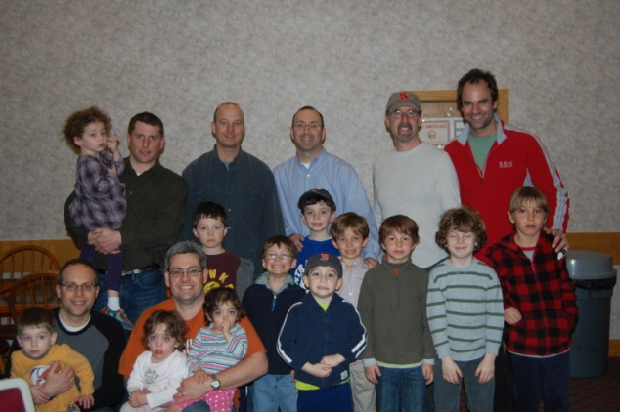
The Award-Winning…
Mom’s Afternoon Off (MAO)
MAO was created in 2010 by the Brotherhood as a way for Temple Emunah’s young Dads
to get together with their children and socialize, while giving their hard-working wives…
well…an afternoon off. In its inaugural year, it was recognized by the Federation of Jewish
Men’s Clubs as the country’s most outstanding Young Men's Program!
This year, we’ve put together “a little of everything for everyone” – indoor, outdoor, active, relaxing, etc. Get these events onto your calendar early for some great fun for you and the little ones!
If you have any questions or suggestions, contact Stephen Reimer at (978) 758-2448 or streimer77@yahoo.com.
Tentative 2011-2012 Calendar*
Date | Time | Event
Sunday, Sept. 18 | 10 AM | Apple Picking with the whole family – bring Mom along!
Sunday, Oct. 16 | 10 AM | Nature walk at Walden Pond
Sunday, Nov. 20 | 3 – 5 PM | Baking cookies
Sunday, Dec. 18 | TBD | Charitable Endeavor TBD
Sunday, Jan. 22 | 3 – 5 PM | Bowl-a-thon
Sunday, Feb. 19 | 10 AM | Sledding
Sunday, March 18 | 3 – 5 PM | Arts & Crafts at Temple Emunah
Sunday, April 22 | TBD | Indoor gym TBD
Sunday, May 20 | 4 – 6 PM | Year-end BBQ for the whole family (Temple playground)
*Details to follow; calendar subject to weather and the whims/great ideas of the participating Dads…

Slide 5
You have found the young men HERE…
Right where they are comfortable…
With their kids, their buddies and their buddies kids!
Baking
Hanukah
cookies
Nature
Hike
Apple Picking
Gutter
Bumper
Bowling
Sledding
Family BBQ
Young Dads’ Agenda

Slide 6
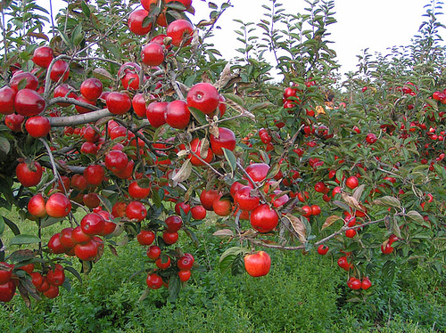
Mom’s Afternoon Off on Sunday, Sept. 18…
…is neither Mom’s Time Off
OR During the Afternoon. Discuss!
We’re kicking off year 2 of the Brotherhood’s Award-winning Mom’s Afternoon Off with a Sunday morning apple picking trip for the whole family!
We are bringing together the whole family to kick off the year so that the Moms can learn first-hand why they should be ensuring that their husbands take the kids to future MAO events!
When | Sunday, Sept. 18 10AM
Where | Meet at Shelburne Farm (106 W. Acton Road, Stow, MA) http://www.shelburnefarm.com/
Who | Moms, Dads and Kids – bring the whole family to get to know each other and learn more about MAO
What | We’ll take care of the first bucket of apples for the first 10 families who RSVP by the deadline
How | Please RSVP to Stephen Reimer (STReimer77@yahoo.com) no later than Thurs. 9/16. Even if you don’t RSVP, feel free to show up anyway!

Slide 7
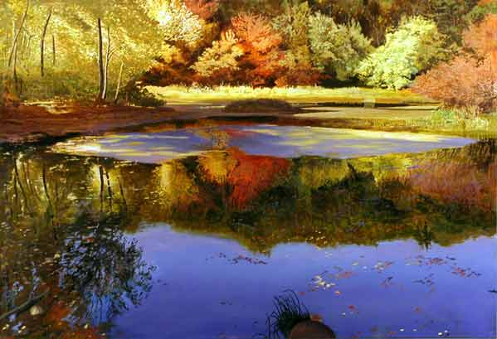
You Don’t Have to be Henry David Thoreau to Join Us on Sunday, October 16!
The Temple Emunah Brotherhood presents a
Mom’s “Afternoon” Off with a leisurely nature walk at Walden Pond.
Henry David Thoreau lived at Walden Pond from July 1845 to September 1847. His experience there is credited with helping to inspire awareness and respect for the natural environment. Because of Thoreau's legacy, Walden Pond has been designated a National Historic Landmark and is considered the birthplace of the conservation movement. It includes 462 acres of protected open space so that visitors from near and far may come to experience the pond that inspired Thoreau. Join us on a leisurely hike through the trails that ring the pond and visit the replica of Thoreau's one-room cabin.
When | Sunday, Oct. 16 10AM
Where | Meet at the Walden Pond Visitor’s Center (915 Walden St., Concord, MA) http://www.mass.gov/dcr/parks/walden/
Who | Dads and their Kids
What | MAO will reimburse the $5 parking fee for the 1st 10 Dads to RSVP. We’ll also bring some healthy snacks for the nature walk.
How | Please RSVP to Stephen Reimer (STReimer77@yahoo.com) no later than Thurs. 10/13.

Slide 8
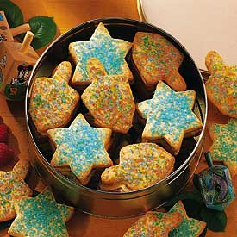
Dads Can Bake Too!
Join the Young Dads of the Brotherhood and their kids on Sunday 11/20, as we bake an assortment of delicious treats!
Imagine the joy on Mom’s face when your little ones bring home cookies that they made for her!!!
Expert baker and Emunah member, Aaron Buckler (of Sisterhood Challah making fame), will show you how to make amazing cookies and other baked treats, and more importantly, how to make sure that the kiddos play a big part in the process.
When | Sunday, Nov. 20 from 3-5PM
Where | Temple Emunah
Who | Dads and their kids
What | We’ll have everything you need for you and your little ones to work together making delicious Kosher baked treats for Mom and your Thanksgiving visitors.
How | Please RSVP to Stephen Reimer (STReimer77@yahoo.com) no later than Thurs. 11/10 so that we can ensure we have enough supplies and ingredients for everyone.

Slide 9
Young Men Program Experiments
“Handyman Committee” meets at Hardware Store 1x/year
  Handyman 101: Basic skills and tools
  Advanced Handyman: Kitchen & Bathroom Tiling
Mom’s Afternoon Off meets monthly Sep-May
Bicycle Repair and Safety met at Bicycle Store
Beer Brewing in the Temple’s kitchen 1x/year
    Unveiled at Membership Dinner with Man Of Year’s Photo on label
Super Bowl Party the evening of World Wide Wrap
Men’s Day 9:45 AM-4PM
  Board Mtg/Buffet Lunch/Beer Brewing /Large Screen Football

Slide 10
CALL TO ACTION
Seek out where young men are. Go TO them.
Interview men & FAMILIES. ASK what matters.
Lower the bar to enter your club. Make it
  EASY for young men to congregate.
  FUN & not available from other committees.
  FREE as frequently as possible
Build affinity groups: Young Dads, Bicyclists, Sports
  Determine the natural group leader and award him funding

Slide 11
THANK
YOU !

