Slide 1

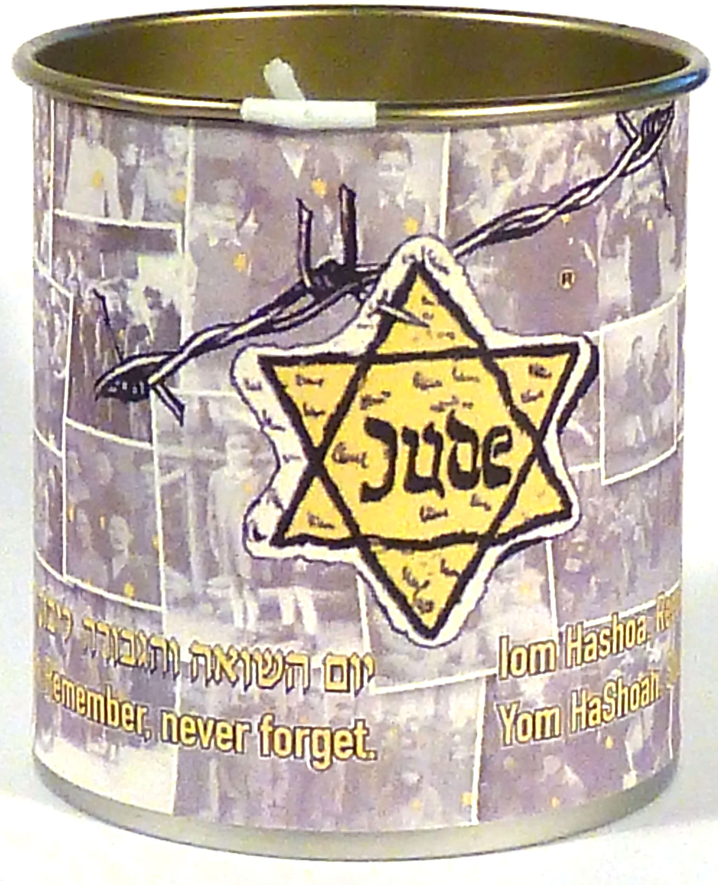
Best Practices to Build A successful
Yellow Candle Program
Presented by
Martin Melnick

Slide 2
Each of you can be most effective by better understanding the yellow candle program
Go to yellow candle home page (www.yellowcandle.org)and review
  History
  Who benefits
  Why we remember
  Review torch award winning programs to bring to your clubs

Slide 3
Purpose of Presentation is to build
Regional candle Participation and address Problems Regional leadership has shared
We have clubs that believe the Candle Program has run its course. They complain
“We lose money when we run the Yellow candle program.”
“We do not have support from Synagogue leadership.”
“We do not have enough volunteers to run the Program.”

Slide 4
Key ideas to learn today
Using Influencers from your Synagogue:
  Rabbi
  Assistant Rabbi
  Synagogue President
  Men’s club President
  Yellow Candle Chairman
MAIL Three Separate requests for donations
Connecting to families with children
Lowering Distribution costs using hand delivery or bulk mail

Slide 5
This process works!
#1. A large synagogue was running a break even or money losing Yellow Candle Program for over four years. After changing the program from one (1) donation request letter to three (3) letters using this marketing approach we will detail,
  the results in the first year netted $1,500 and
  the second year $3,000.
This method enlists the help of the two most influential individuals in your synagogue - the Rabbi and the Synagogue/Temple President.

Slide 6
First Influencer
Rabbi Letter
Have your Rabbi prepare a letter encouraging congregants to light the yellow candle in observance of Yom HaShoah and encourage donations of any amount.
The letter should be sent six weeks before distribution of your candles. The letter will be more effective if you include what charity your congregation’s donation will be used for. In this example, 55% of all donations were received before candles were distributed.
You may experience some congregants making two donations using this multiple request format.
Sample Rabbi letters are listed at www.yellowcandles.org at the marketing Material tab then choose communication ideas tab.

Slide 7
Second Influencer
Synagogue President and Men’s Club President
When packing your candles, Include a donation request letter signed by the Synagogue and Men's Club President with each candle.
letter should have language about the mitzvah to make a donation in the name of someone of blessed memory.
Sample president’s letters are on fjmc web site
To help your campaign have greater impact, Request recipients to post a picture of their candle lighting to social media. #YellowCandle: Twitter, Instagram, snapchat, etc.
Another way to make your campaign more effective is to ask recipients to use Facebook live read meditation while lighting candle.

Slide 8
Second insert meditation
You can Personalize the meditation
or
Kel Maleh Rachamin with names of
children that perished in the Holocaust
(Details of this addition will be discussed later)

Slide 9
bonus
The Presidents’ letter inserted with the candles can create donations equal to the Rabbi’s letter.
Unexpected bonus: many congregants make a second donation.
It is likely that a six (6) week time frame between the two requests is a factor.

Slide 10
Third Influencer (optional)
Yellow candle chairman
Shavuot letter
Shavuot is another Jewish holiday when it is customary to make donations.
Send a reminder request letter to congregants who have not made a donation after having a Yellow Candle delivered to them. The letter should be sent under the name or names of the Yellow Candle chairman.

Slide 11
Sample Excel spread sheet
for tracking candle donations
 | 2019 Yom HaShoah Donor List |  |  |  |  |  | 2019 | 2019 | 2019 | Total | 2020 | 2020 | 2020 | Total
Last Name | Full name with titles | Family salutation | Street address (active) | City-State-Zip (active) | ST | ZIP | Rabbi | Delivery | Shavuot |  | Rabbi | Delivery | Shavuot
 |  |  |  |  |  |  | Donation | Donation | Donation |  | Donation | Donation | Donation
Note: The Excel file is available for download from the Yellow Candle website.

Slide 12
Make an Emotional connection with your community
ADD the name of A holocaust child
First Name | Last Name | Date of Birth | Place of Residence | Place of Death | Date of Death | Age
JUDITH | GOTTESMAN | 1939 | MUKACEVO | AUSCHWITZ | 23/5/1944 | 5

Slide 13
Adding the Child’s Name…
Creates an Emotional connection with your community.
During the Holocaust, the Nazis and their collaborators murdered over 1.5 million Jewish children under the age of 16.
Personalize your family’s observance of Yom HaShoah by providing each family with the name and homeland of a young victim who may have no surviving relatives to light a candle in his or her memory.
The FJMC Yellow Candle website, has lists of 1500 names of children who were murdered during the Holocaust, which can be downloaded.

Slide 14
Two methods to include holocaust children
Purchase label card stock 1” X 4” and mail merge child’s history and insert unique card with every candle distributed. Ask congregants to place card against candle when lighting and take picture and post on social media to help your program become viral on the internet. You will help this major international educational opportunity of the FJMC Yellow Candle Program.
Another way to include children’s names is to mail merge them into the Yellow Candle Meditation letter. Many Men’s Clubs and Brotherhoods who have used the Holocaust children merged meditation have experienced an increase in donations from synagogue families with children.
The FJMC website has mail merged sample meditation prayers ready to use and has instructions on how to do the Mail Merge.

Slide 15
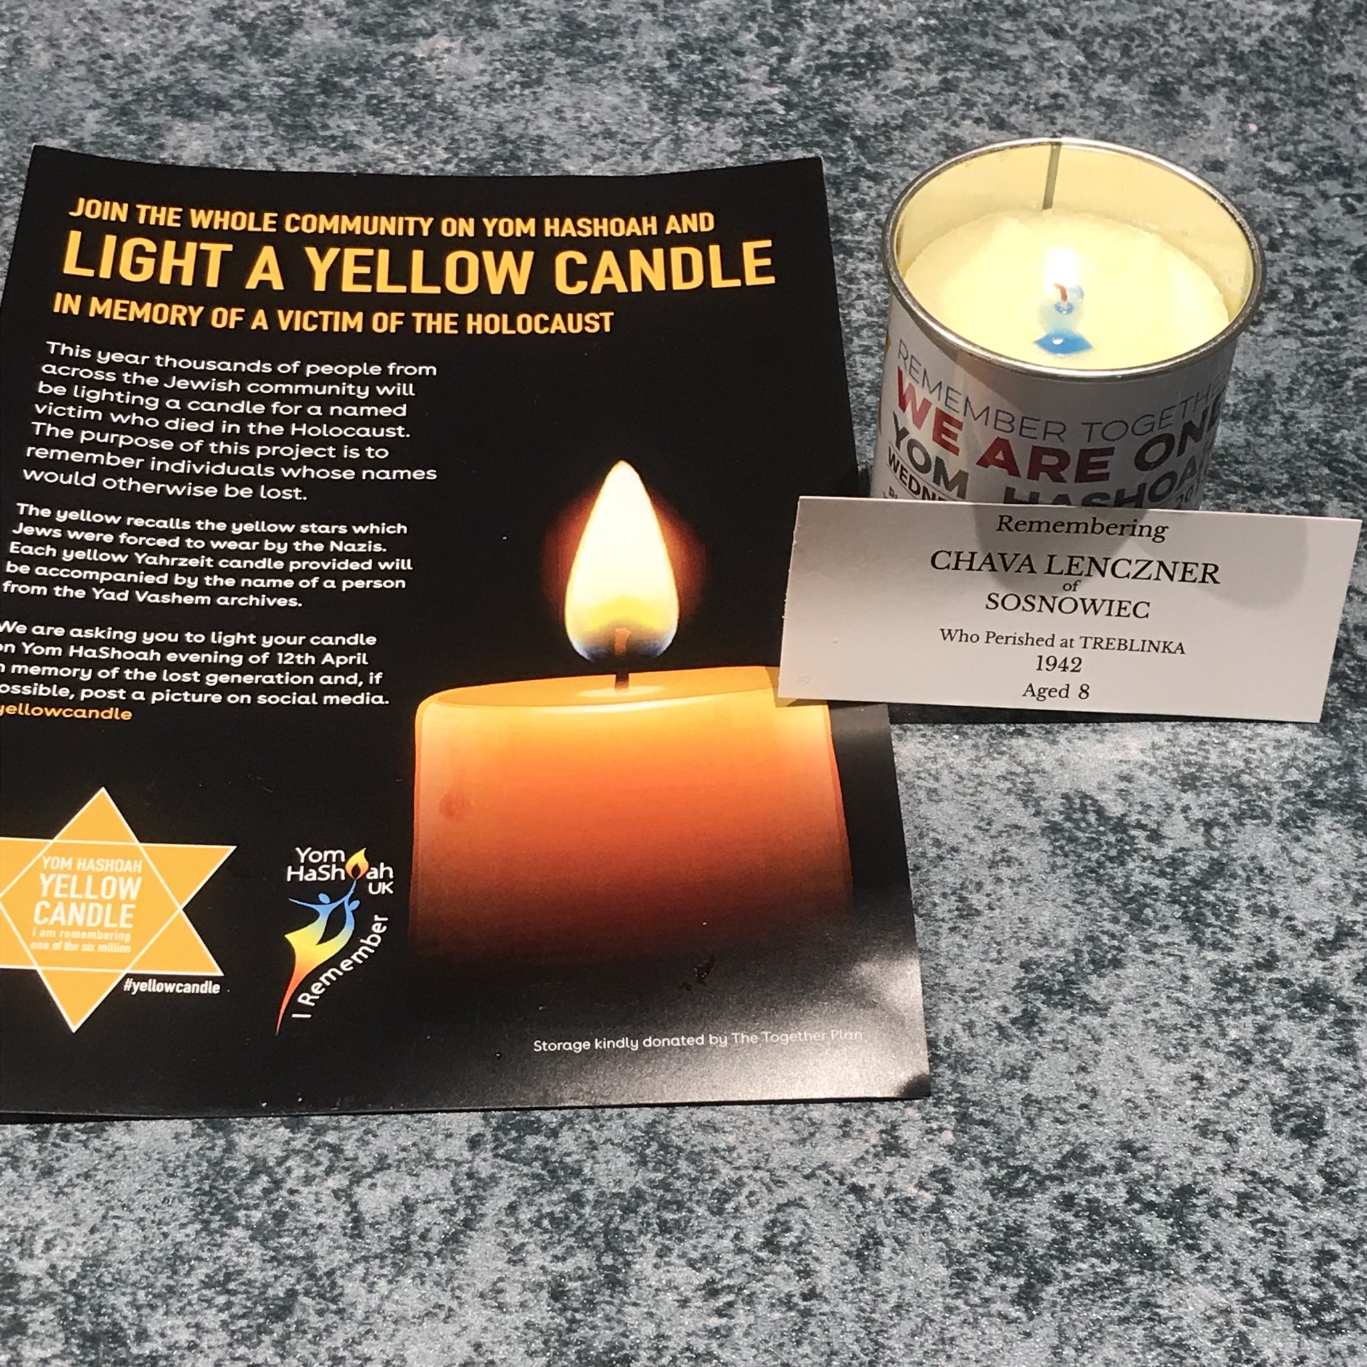
Sample post to social media

Slide 16
Making Candle program more profitable through distribution
Hand Distribution can save up to thousands of dollars vs mailing
  You can Involve parents and children in religious school
  You can involve parents and children in usy
  You can involve extended men’s club membership (those who may not be actively involved in other activities)
  You can involve volunteers that delivered shalach manos
  You can involve volunteers from general synagogue membership
Mailing by United States Postal Service (usps) is very expensive. When volunteer delivery is not an option review new USPS Bulk mail guidelines on the FJMC web site and candle Guide. www.yellowcandle.org

Slide 17
How can we participate? our synagogue has limited volunteers.
Answer: use direct mail shipment option. Information is available on the yellow candle web site and in the yellow candle guide.
  Minimum order 100 candles
  You’ll be able to send synagogue letterhead for cover letter.
  Send wording for cover letter and meditation you want to use
  You’ll send Excel spread sheet with address info as instructed
  Prepayment required, dates and pricing on web site

Slide 18
Changing the delivery method changed the program
For years one of our men’s club “bulk mailed” candles to congregants.
The cost of mailing and 10% donation return rate created a money losing program.
They changed their distribution method to a hand delivery program, which can be easily adapted to your congregation, and made the program profitable. And such method allowed holocaust education to be extended to the families who participated!

Slide 19
What this club did to implement….
The congregation’s religious school represented 14% of total families.
The Club worked with the school director to create family name labels by grade. They also got agreement of which were the best days to have the school distribute the candles. (This is critical because of the secular vacation days that occur around the time candles are distributed.)
On candle packing day, they packed grocery bags by grade with family names on the candle boxes. Only the oldest child (in a multi child family) received candles.
They used magic markers to boldly mark the bags so they would get to the correct grades and then delivered the bags to the school office.

Slide 20
Home delivery Example #2
This congregation’s Chai Society (over 55 years old) programs average over 100 attendees. attend their program to distribute candles and delete those names from our home delivery list.
Look for other large groups within the congregation that meet at the synagogue to hand deliver the candles too.
Create a Home delivery program spreadsheet. obtain synagogue membership list by full name with title, family salutation, Street, city state zip as one cell using an Excel spread sheet. Additionally It is preferable to have zip as separate cell. After deleting school families who were delivered separately, Chai member families and candles picked up at the synagogue, and were provided a home delivery list.

Slide 21
Home delivery
a. At first column A insert blank column.
b. Copy zip+4 into first column.
c. Highlight full document.
d. On Excel toolbar far right click drop down arrow at Sort & Filter then select A-Z. Database should than be in order by town by zip+4. A master delivery spreadsheet can be found on FJMC website.
e. Count about 25-30 names and look for best spot by zip to create a delivery route. Insert a couple of blank lines and on top of section assign to a volunteer by putting the volunteer name in bold and large type font.
f. To determine number of delivery volunteers needed, divide master list by 25. Recruit volunteers from Men's Club, USY, religious school parents and children, and others in the synagogue. When possible pair father and child or driver and runner to speed up delivery.

Slide 22
Delivery routes
You can map your delivery routes by using software like https://www.drivingrouteplanner.com or https://www.myrouteonline.com.
Using such method, a volunteer can deliver 25-30 candles in two hours, preferable with a helper (one to drive and one to bring to door).
Create separate excel sheet for each route, this is emailed to the volunteers to help them organize. Boxes or paper bags, clearly labeled with each volunteer’s name are preloaded with the correct number of candles, Yellow Candle door bags and the master delivery list for pick up at the synagogue.
Note: Some candles cannot be delivered because of gated communities and security buildings. Ask volunteers to bring those back and mail this small quantity that could not be hand delivered.

Slide 23
Thank you for joining this presentation
This PowerPoint is available on the yellow candle web site.
Please invite all of your clubs to view this training, especially clubs that are dormant or have had a negative candle experience.
Discuss this training during your regional board meetings.

Slide 24
Questions
Contacts
Marty Melnick, mmelnick@fjmc.org, Cell: 860-523-5881
Greg Gore, ggore@starpower.net, Cell: 301-461-7766

