Slide 1

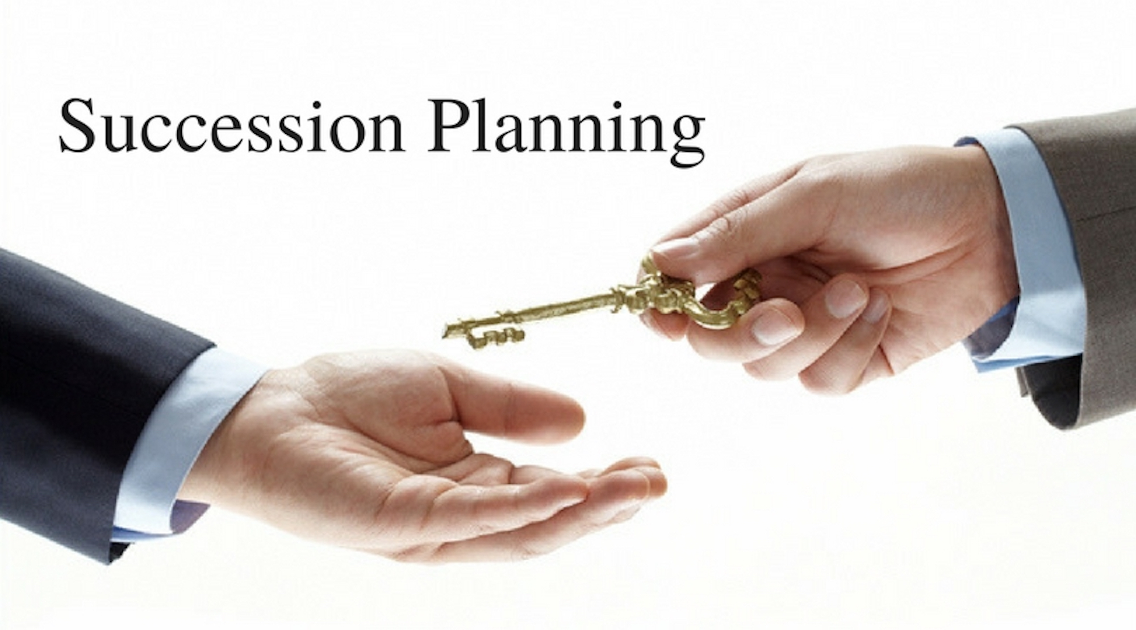

Succession Planning
Paul Davidson
May 15, 2022

Slide 2


Importance of Succession
Leadership burnout
Stagnant programming
Overreliance on small number of leaders
Appeal to new and younger members
Freeing existing leaders to go to the next level
Abandoning “this is how we’ve always done it”
Future club/regional growth

Slide 3

It All Starts with
Membership
Greet potential members enthusiastically
Find out what they are seeking
Learn about their interests
Explain how membership may benefit them
Introduce them to others
Find a small role for them to help
Develop programs to fit new member needs

Slide 4
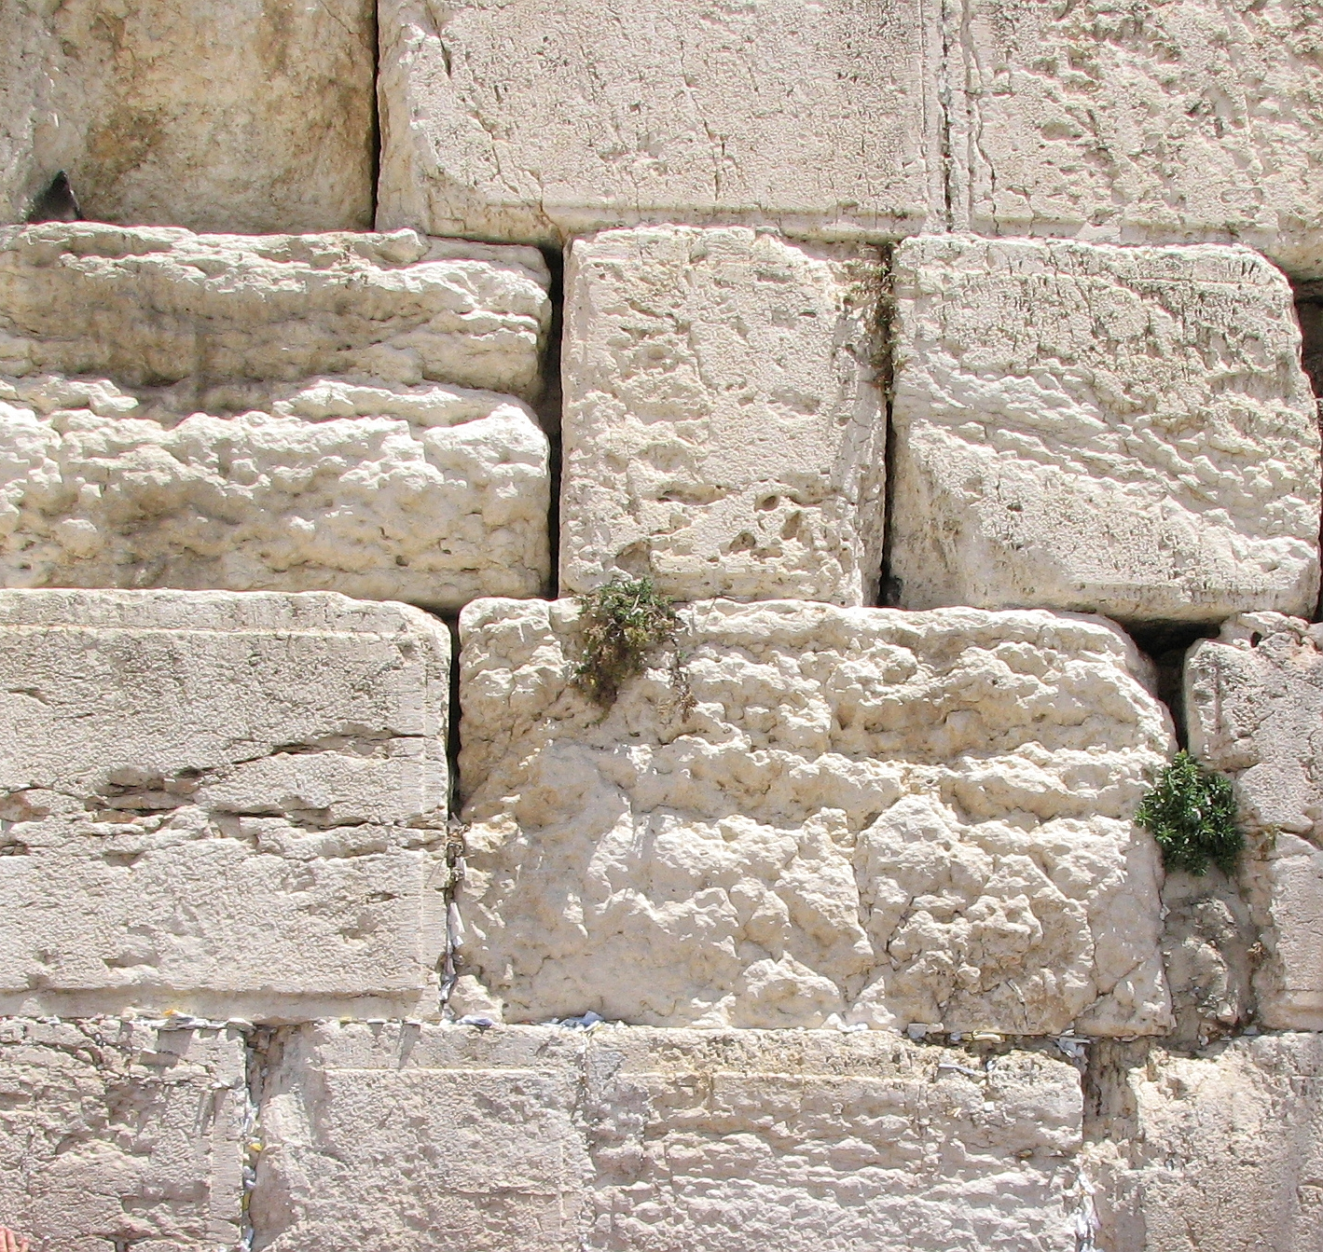
Committees: the Foundation of Future Leaders
Use event planning as a forerunner to committee involvement
Engagement in committees develops leadership skills
Start small and offer positions which match interests and abilities
Be as positive and encouraging as possible to increase interest and confidence
Active members become future leaders

Slide 5

Qualities of a Leader
Seeks to serve
Strives to inspire
Gives but doesn’t seek kavod (credit)
Listens more than speaks
Thinks before acting
Acts rather than reacts
Conveys a vision
Teaches by example
Communicates clearly
Brings people together
Earns the respect of others

Slide 6
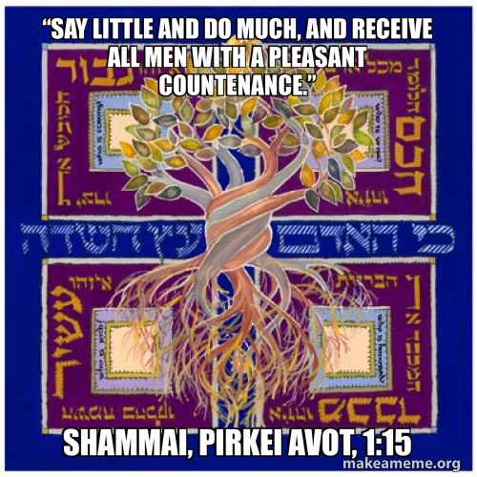
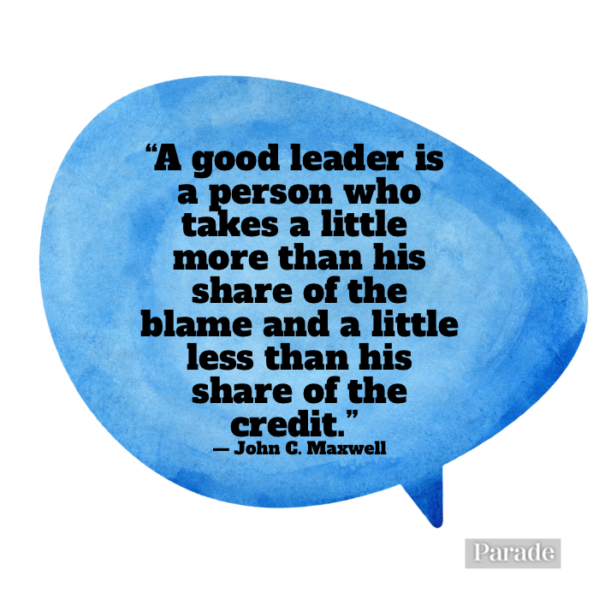
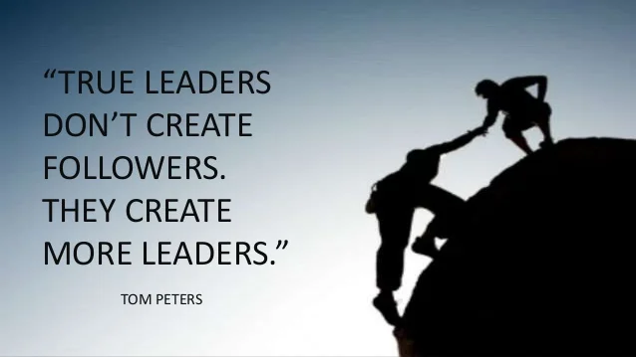

Slide 7

Developing a Map for the Future
Assess your current club/region strengths and weaknesses
  Programming
  Membership
  Leadership
Explore your leadership needs for the next several years
Evaluate and adjust current succession plan
Tapping present leaders vs developing new leaders
Help create a tangible big vision of where you want to go
What will be needed to get you where you want to be?

Slide 8

The Nominating Committee
Nominations may be handled by the committee, officers, and past presidents
Identify individuals who meet the competencies of a given role
Present the slate of officers at a board meeting
Check your by-laws to determine nominating committee guidance
Utilize past leaders as much as possible to scout talent
Asking someone to fill a role may yield immediate results or may plant a seed for future involvement
On the regional level, club visitation is a critical part of getting nominees
Tapping into recent club leadership is most productive

Slide 9


Encouraging Growth
Allow time for development
Nourish interests
Give room to spread
Be the light
Help develop roots
Learn what makes them unique
Encourage reaching new heights
Offer protection
Stand by but don’t crowd
Share the joy

Slide 10
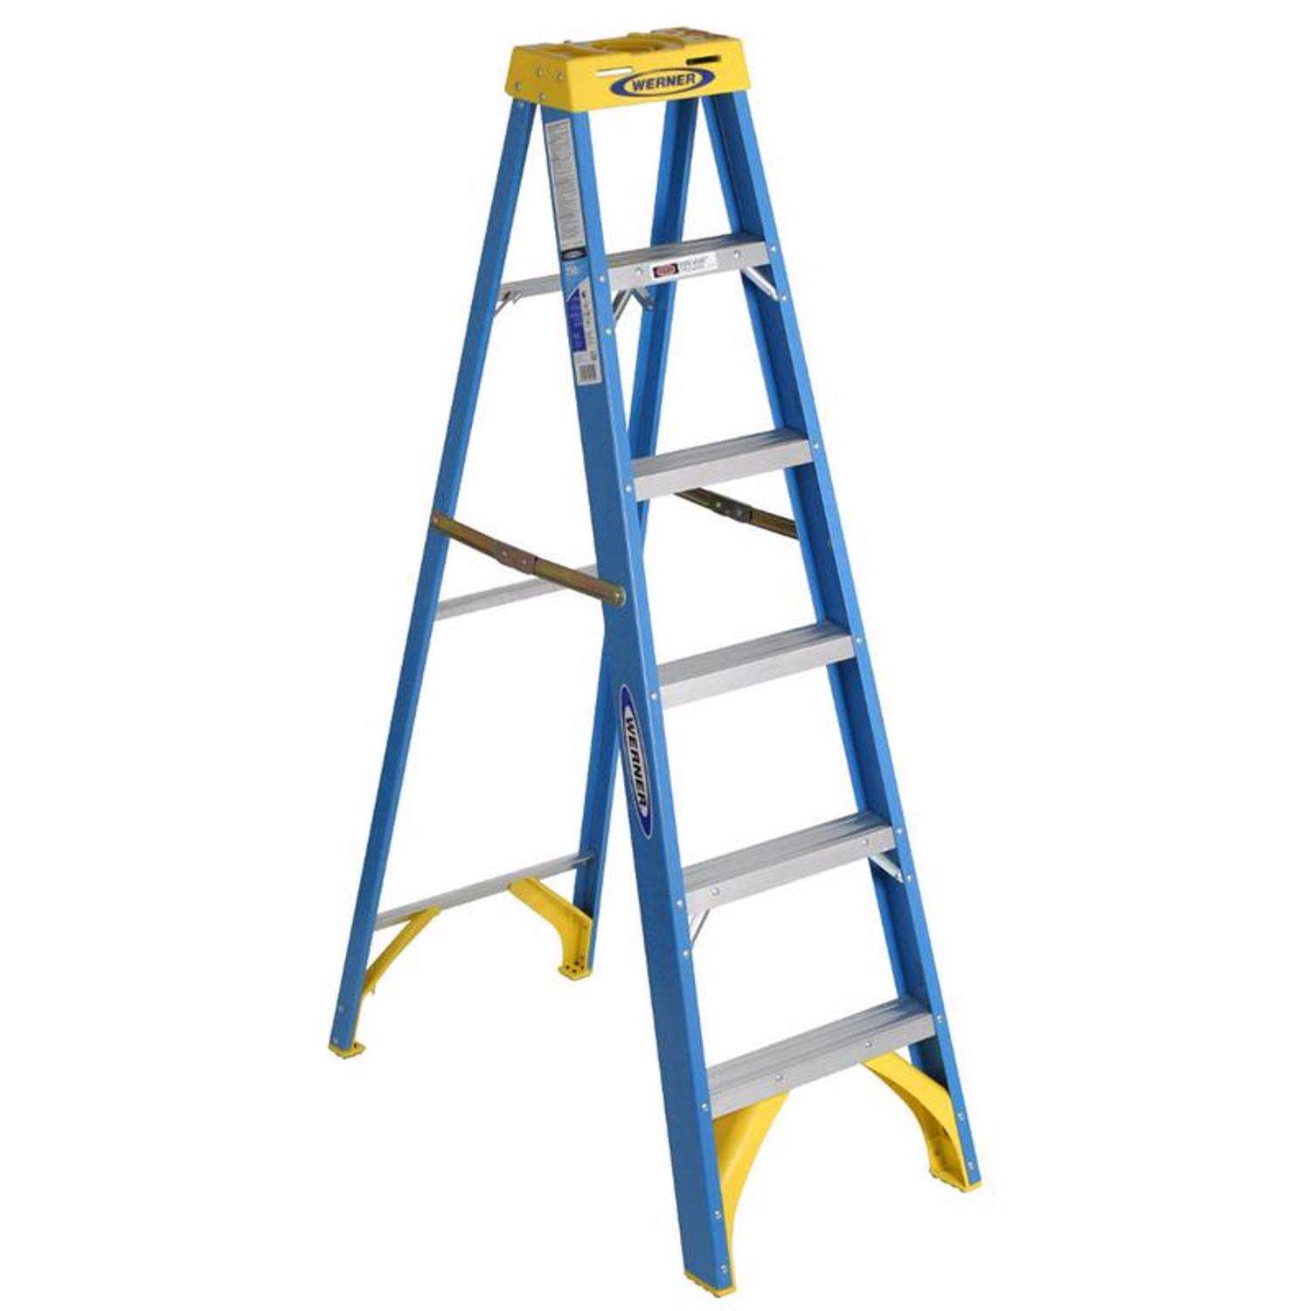
The Growth Ladder
Intuitive natural progression
Set expectations
Reward excellence
An honor to serve
Committee Member
Committee
Chair
Officer
IPP
President
EVP
VP
Repeat for Regional and International FJMC Positions
from Allan Kahan

Slide 11

Long Term Planning
Create commitment expectation
4-8+ years of engagement
Secretary or Treasurer
VP
2nd VP
EVP
President
Immediate Past President

Slide 12
Critical Steps
2nd or Admin VP commits to becoming EVP
EVP commits to being president
Make sure president has plenty of support
President/nominating chair help select new leaders
Keep immediate past president involved
Start the process 6 months in advance
Rely on personal contact, not simply email invitations
Strategize who should make the ask
Fill your slate completely

Slide 13

Triad Approach
Utilizes three-person leadership:
  Current leader – takes responsibility
  Past leader – offers historical view and mentoring
  Future leader – helps and prepares to take over
Builds continuity
Provides support and mentoring
If you want a red-hot group, be white hot
Develops leadership skills
Enhances successful programming
Past leader
Future leader
Current leader

Slide 14
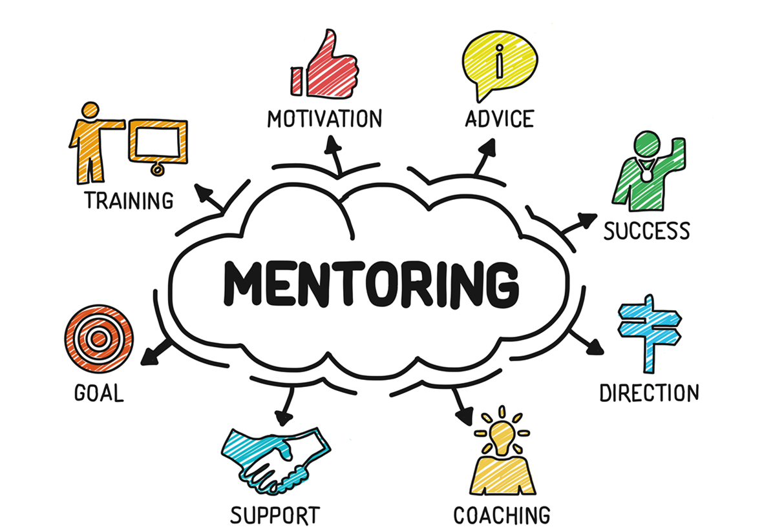

Slide 15

FJMC Resources on fjmc.org
Biennial Convention
Leadership Development Institute (LDI)
Consultants
Volunteer Leadership Tips
Club Membership Campaign
Online Webinars
Podcasts
FKMC Advantage
Attracting Younger Members to Your Club
Torch Awards
Resources for Leadership

Slide 16





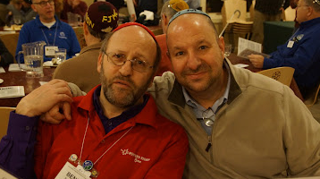
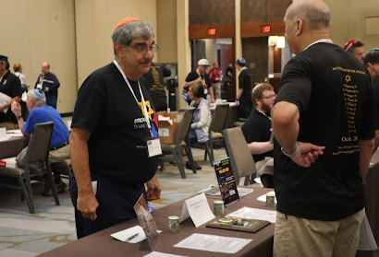

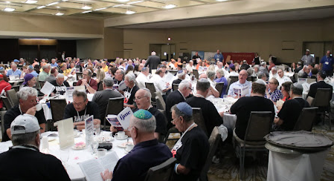
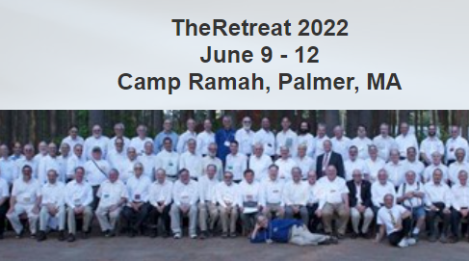

Meetings
“If you want to strengthen your club and create leaders, get your members to retreats and the fjmc convention.”
Paul Davidson

Slide 17

Succession planning means success in developing leaders
  Focus on attracting new members
  Offer small roles to start
  Committees are foundational to leadership
  Personal touch of the nominating committee
  Growth ladder with multi-year terms
  Increasing responsibility prior to presidency
  Keep former leaders involved, provide mentoring
  Use the Triad Approach
  Encourage participation in ongoing training

Slide 18


